Slide 1
Grant Walk-Through
Notes:
On Day 1 of the Summit, we distributed copies of Literacy Line grant to everyone, and you had the option of using this when answering the visual representation guiding questions.

Slide 2
Goals
Examine the Texas Literacy Initiative (TLI) grant
Align TLI grant goals to Literacy Line goals
Plan next steps for implementation and support
Notes:
During this session, we’ll:
READ GOALS ON THE SLIDE.

Slide 3
TLI Grant: A Closer Look
Using the TLI grant, we will:
Become familiar with the grant purpose and goals
Review and discuss Literacy Line goals
Review timelines and professional development activities
Review measurable targets
Discuss future actions
Plan for implementation
Notes:
Using the TLI grant, we will:
READ THE BULLETS ON THE SLIDE.
Getting to know some of the important parts of the grant and how they connect to the Literacy Lines objectives will be essential in establishing a foundation for the TLI. With this in mind, we structured this session so that you (1) learn about components of your Literacy Line grant, and (2) spend time with your leadership teams discussing what it means for you. In doing this, we believe you’ll be better equipped to ask questions and become more familiar with what is expected of you.

Slide 4
Annotated Table of Contents
2
Notes:
Please locate Handout 2. We will use the Annotated Table of Contents to identify and document some pages of your Literacy Line grant.
The handout includes the (1) Schedule number; (2) section name and description; and (3) page number. You will be filling in the page numbers as we guide you through the grant: providing an overview of various elements and documenting important sections for future reference.
Becoming familiar with your grant at the beginning of implementation will assist you in knowing more about TLI, understanding your Literacy Line goals, and planning for sustainability.

Slide 5
Schedule 4: Program Summary and Application Requirements
Part 1: Grant Program Information: Purpose
The purpose of the Texas Literacy Initiative (TLI) grant is to
improve school readiness and success in the areas of language
and literacy for disadvantaged students in targeted school
districts, including their associated ECE providers, who will use
the model of Literacy Lines to implement the Texas State
Literacy Plan (TSLP).
Reflection:
How will participating in this grant promote a literacy culture for all age/grade level groups?
Notes:
READ THE SLIDE (EXCEPT THE REFLECTION QUESTION).
Please locate Schedule 4, Part 1 in your grant. Once there, record the page number on Handout 2 and review the contents of this schedule.
GIVE PARTICIPANTS TIME TO REVIEW.
With your tablemates, reflect on the question posed on the screen.

Slide 6
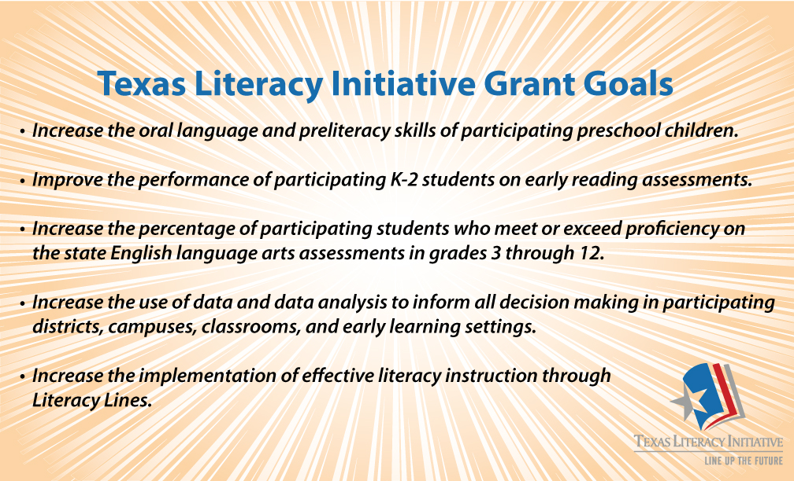
Schedule 4: Program Summary and Application Requirements
Part 1: Grant Program Information: Goals
Notes:
We have reviewed and worked with the TLI Grant Goals several times during the Summit. As we continue reviewing the grant, remember that these are the goals we want to accomplish. Keep these in mind during your table discussions and while reviewing the contents of your grant.

Slide 7
Schedule 4: Program Summary and Application Requirements
Part 2: Application Requirements List: Statutory Requirements
Review the Statutory Requirement descriptions.
Reflection:
How do the three requirements listed support each other?
What does each requirement mean for your district, campus, or site?
Notes:
READ THE SLIDE (EXCEPT THE REFLECTION QUESTION).
Please locate Schedule 4, Part 2 in your grant. Once there, record the page number on Handout 2 and review the contents of this schedule.
GIVE PARTICIPANTS TIME TO REVIEW.
With your tablemates, reflect on the questions posed on the screen.

Slide 8
Schedule 4: Program Summary and Application Requirements
Part 2: Application Requirements List: TEA Program Requirements
Review the TEA Program Requirement Descriptions.
Reflection:
What supervision and/or support will your campus/site need in order to meet these requirements?
Notes:
READ THE SLIDE (EXCEPT THE REFLECTION QUESTION).
Please locate Schedule 4, Part 2 in your grant. Once there, record the page number on Handout 2 and review the contents of this schedule.
GIVE PARTICIPANTS TIME TO REVIEW.
With your tablemates, reflect on the questions posed on the screen.

Slide 9
Schedule 4B: Program Description: Needs and Objectives
Part 1: Target Population
Part 2a: Magnitude and Severity
Reflection:
How will the objectives of the TLI target the specific gaps, barriers, or weaknesses that have been identified for your Literacy Line?
Notes:
READ THE SLIDE (EXCEPT THE REFLECTION QUESTION).
Please locate Schedule 4, Part 2 in your grant. Once there, record the page number on Handout 2 and review the contents of this schedule.
GIVE PARTICIPANTS TIME TO REVIEW.
With your tablemates, reflect on the questions posed on the screen.

Slide 10
Schedule 4B: Program Description: Needs and Objectives
Part 2c: Program Effectiveness
Familiarize yourself with the measurable goals to determine program effectiveness at each of the age/grade level groups.
Reflection:
How do these goals align with the TLI Grant Goals?

Slide 11
Schedule 4B: Program Description: Literacy Line & Literacy Program
Describe key human resources in your Literacy Line and determine how these individuals might best support all age/grade level groups.
How will your Campus/Site-Based Leadership Team provide support in implementing a comprehensive and coherent literacy program for all age/grade level groups?
Notes:
We learned during previous sessions that:
A Literacy Line is a vertical collaborative among feeder-pattern campuses within an LEA or among partnering eligible LEAs. Each Literacy Line is responsible for providing instructional and programming alignment for language, preliteracy, and literacy development and ease the transition for children across their entire learning careers.
ALLOW TIME FOR PARTICIPANTS TO REVIEW SCHEDULE 4B, PROGRAM DESCRIPTION: LITERACY LINE AND LITERACY PROGRAM.
Knowing this, discuss the statement and question with your tablemates.

Slide 12
Schedule 4B: Program Description: Program Management
Part 3: Activity Timeline
Review the activity timeline of the major project management activities for your Literacy Line.
Reflection:
How will this timeline impact the literacy programs at all age/grade level groups?
Notes:
READ THE SLIDE (EXCEPT THE REFLECTION QUESTION).
Please locate Schedule 4B, Part 3 in your grant. Once there, record the page number on Handout 2 and review the contents of this schedule.
GIVE PARTICIPANTS TIME TO REVIEW.
With your tablemates, reflect on the question posed on the screen.

Slide 13
Schedule 4B: Program Description: Curriculum and Instruction
Part 1: Curriculum
Review and highlight the program and materials used at your level of instruction.
Reflection:
How are these programs and materials currently being used in your district and/or at your campus/site?
How will these programs and/or materials assist your district, campus, or site in accomplishing the TLI Grant Goals?
Notes:
READ THE SLIDE (EXCEPT THE REFLECTION QUESTION).
Please locate Schedule 4B, Part 1 in your grant. Once there, record the page number on Handout 2 and review the contents of this schedule.
GIVE PARTICIPANTS TIME TO REVIEW.
With your tablemates, reflect on the questions posed on the screen.

Slide 14
Schedule 4B: Program Description: Curriculum and Instruction
Part 2: LASERS
Leadership
Assessment
Standards-based instruction
Effective instruction framework
Reporting and Accountability
Sustainability
Reflection:
What LASERS components are currently in place to implement and sustain the goals of the TLI?
Which components, if any, of the LASERS model may need further development?
Notes:
You learned during yesterday’s session that the LASERS acronym stands for (READ THE SIX COMPONENTS)
Please locate Schedule 4B, Part 2 in your grant. Once there, record the page number on Handout 2 and review the contents of this schedule.
GIVE PARTICIPANTS TIME TO REVIEW.
With your tablemates, reflect on the questions posed on the screen.

Slide 15
Schedule 4B: Program Description: Professional Development
Part 1: Professional Development Approach
Read over the current professional development plan for your Literacy Line.
Reflection:
How will these professional development activities assist your district, campus, or site in meeting the TLI Grant Goals?
Notes:
READ THE SLIDE (EXCEPT THE REFLECTION QUESTION).
Please locate Schedule 4B, Part 1 in your grant. Once there, record the page number on Handout 2 and review the contents of this schedule.
GIVE PARTICIPANTS TIME TO REVIEW.
With your tablemates, reflect on the question posed on the screen.

Slide 16
Schedule 4B: Program Description: Professional Development
Part 2: Activity Timeline
Review the timeline for your Literacy Line.
Reflection:
How do you foresee these activities being accomplished?
How will your district, campus, or site support the professional development activities outlined in the timeline?

Slide 17
Schedule 4C: Performance, Assessment, and Evaluation
Review all pages that describe how your Literacy Line will comply with the reporting and evaluation requirements of the Texas Literacy Initiative.
Reflection:
As a Campus/Site-Based Leadership Team, how will you assist your faculty and staff in understanding these requirements?
How will you monitor and provide support to ensure these requirements are met?
Notes:
READ THE SLIDE (EXCEPT THE REFLECTION QUESTION).
Please locate Schedule 4C in your grant. Once there, record the page number on Handout 2 and review the contents of this schedule.
GIVE PARTICIPANTS TIME TO REVIEW.
With your tablemates, reflect on the questions posed on the screen.

Slide 18
Schedule 4C: Performance, Assessment, and Evaluation
Part 2: Performance Targets
Review the four performance targets listed on this schedule.
Reflection:
How will these measures and targets help your district, campus, or site achieve the goals of the Texas Literacy Initiative?
How will you support your district, campus, or site in meeting these performance targets/goals?
Notes:
READ THE SLIDE (EXCEPT THE REFLECTION QUESTION).
Please locate Schedule 4C, Part 2 in your grant. Once there, record the page number on Handout 2 and review the contents of this schedule.
GIVE PARTICIPANTS TIME TO REVIEW.
With your tablemates, reflect on the questions posed on the screen.

Slide 19
Texas Literacy Initiative
“. . . there are virtually no documented instances of troubled schools being turned around in the absence of intervention by talented leaders. While other factors within the school also contribute to such turnarounds, leadership is the catalyst.”
(Leithwood, Louis, Anderson, & Wahlstrom, 2004, p. 17)
Notes:
We end our grant walk-through with this quote.
We hope this session has provided a deeper look into your Literacy Line grant and helps prepare you for future implementation.

